Slide 1
The small world phenomenon
Two strangers meet; what are the odds that they would have an acquaintance in common?
  How about being two (3, 4, 5, .... k) steps away from one another? (Pool and Kochen 1978)
  Infinitesimally small if connections formed at random
    Especially given the order of the underlying (world) graph
  Not that small in real world networks
    Why?
    Does it characterize other (non-social) networks?
    How does the SW property arise?

Slide 2
The small world phenomenon
A given (large-scale) network is a "small world" if:
  The order of the graph (N) is large
  The graph is sparse (any node is on average connected to only a relatively small number of other nodes k)
    k ~ 10² in human social networks (Pool and Kochen 1978)
  Graph is decentralized (max degree k is much smaller than the order of the graph N)
  The network exhibits clustering (friends of friends tend to be friends)

Slide 3

Small World - Milgram's 1968 Experiment
Target (Boston stockbroker)
  296 participants ("starting persons")
  196 from Nebraska
    100 Stockbrokers
    96 Random
  100 from Boston
  217 forwarded packet so get to target person
  453 Intermediaries enlisted by the participants

Slide 4

Small World - Milgram's 1968 Experiment
64 completed chains (29%)
  Mean path length: 5.2

Slide 5

Small World - Milgram's 1968 Experiment
232 incomplete chains (71%)
  Mean path length of incomplete chains: 5.2

Slide 6
Small World - Milgram's 1968 Experiment
Out of the 64 completed chains 26 people made the final link
16 (25%) reached the target via a single neighbor: "Mr. G."
  Another accounted for 10
  Another for 5
  The top three account for 48% of completions

Slide 7
Small World - Milgram's 1968 Experiment
86% of starting persons sent the letter to friends and acquaintances
14% send it to relatives
  There was age, gender and SES homophily in the choice of intermediary

Slide 8
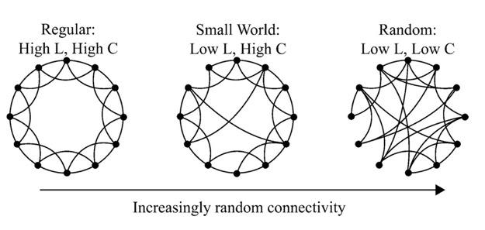
The Watts and Strogatz Model
p - randomness parameter (proportion of links that are allowed to be non-local)
G = (N, E) N vertices, E edges
L(p) = Average path length between two vertices
C(p) = Average vertice clustering coefficient

Slide 9
The Watts and Strogatz Model
p = 0 (regular lattice)
  L ~ n/2k >> 1
  C ~ 3/4
  highly clustered, large world, L grows linearly with n

Slide 10
The Watts and Strogatz Model
p = 1 (random graph)
  L_{random} ~ ln(n)/ln(k)
  C_{random}~ k/n
  low clustering, small worlds, L grows logarithmically with n

Slide 11
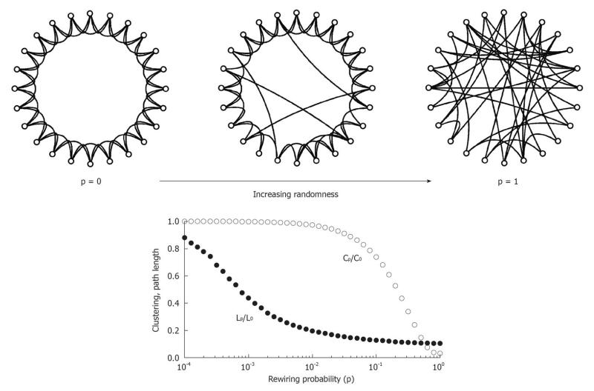
The Watts and Strogatz Model
Tradeoff: Clustering and short path length (small world). But?

Slide 12
The Watts and Strogatz Model
Range of p where L(p) is small world like AND C(p) is high (like in real social networks)

Slide 13
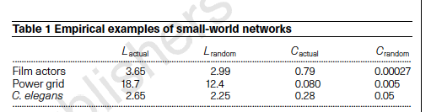
Shortcuts
Random rewiring --> shortcuts
  high nonlinear effect on L
  only a linear effect on C
Only need a small fraction of short cuts
Implications for diffusion

Slide 14
Implications of the small world phenomenon
Diffusion (percolation) and search
Network structure and diffusion
Global Network Properties
  Average Path Length
  Clustering Coefficient
Generative Processes (Mechanisms)
  Clustering Mechanism (triadic balance)
  Random rewiring

Slide 15
Newman : Models of Small World
Terms
  N vertices
  z average vertex degree
  1/2Nz - edges
  G = (N, 1/2Nz)
Random graph
  Small world effect, Z^{D} = N
    how far out to you have to go to reach everyone?
  Diameter = D = log N/log z
  Small World -- logarithmic increase in D with size of network
  C = z/N
  z -- Poisson distribution
Notes:
Average degree * N divided by 2 is number of edges
z Poisson distribution
Lattices: constant Z, clustering = 3/4, large world

Slide 16
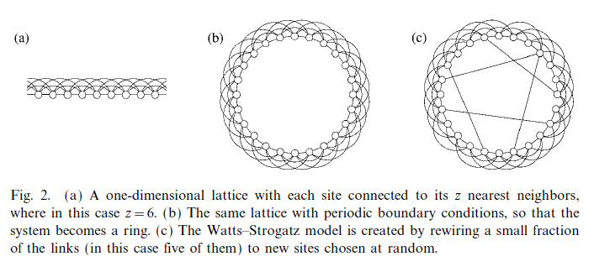
Newman : Models of Small World
Real Social Networks
  Small World
  Clustering
  Power-law degree distribution

Slide 17
Growth Models
Alpha Model (Watts 1999)
  People introduce pairs of friends to one another
  Transitivity and triadic closure
  Clustering and communities (isolated islands)
Preferential Attachment (Barabasi & Albert 1999)
  Rich get richer
  Add edges based on vertex degree
  Rate at which degree increases is proportional to present degree
  Power laws
  Creates small world via hubs

Slide 18
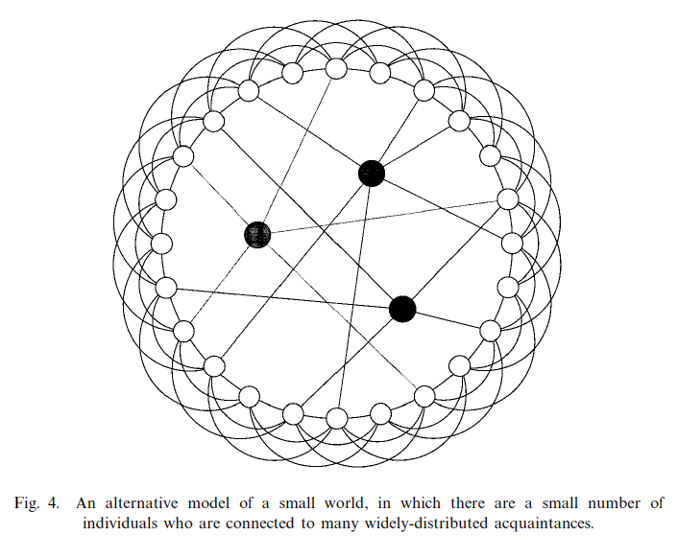
Growth Models
Watts - Strogatz
  random rewiring of lattices - bridges
  long range connections
Vertex Connectors
Local information and the small world phenomenon

Slide 19
Uzzi & Spiro: Small World Defined
Clustering and small world
  SW connectivity allows creative material to circulate to other clusters
Short cuts between clusters
Small world network
  Short average path length
  (PL ratio = PL_{actual}/Pl_{random} --> 1)
  High clustering (CC ratio = CC_{actual}/CC_{random} > 1)
  Q = CC ratio/PL ratio
  Larger Q the more small world the network

Slide 20
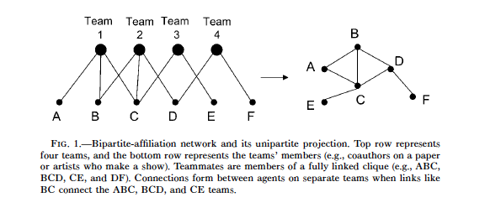
Uzzi & Shapiro: Bipartite Network
Teams and Members:
  Within teams - clustering
  Clustering over and above within-team clustering (between team clustering)
    CC ratio > 1: between team clustering
  Much greater than 1, repeated pairing (B-C link)

Slide 21
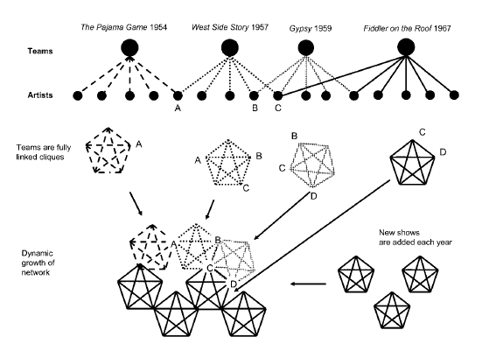
Two SW Mechanisms
Structural:
  Links between clusters --> diffusion
Relational:
  Links between clusters made up of repeated ties and third-party ties --> cohesion

Slide 22
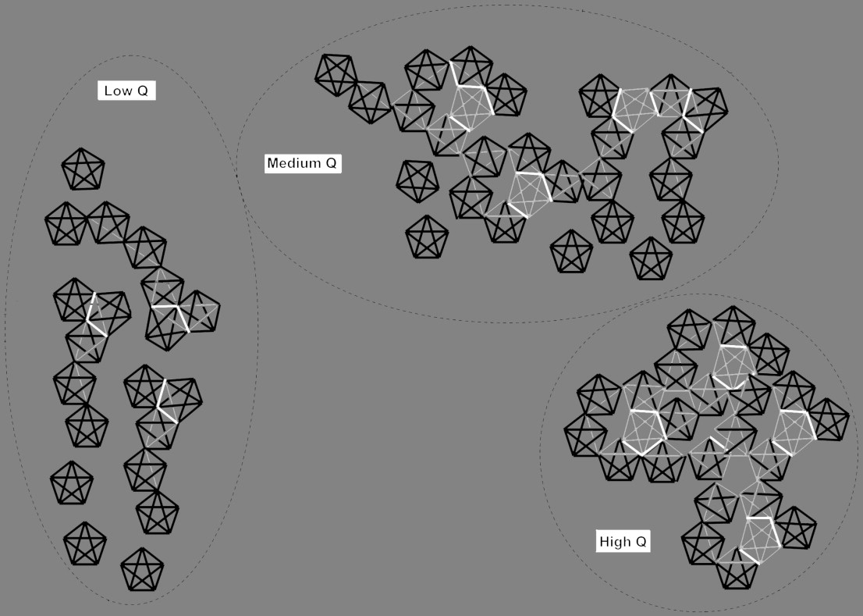
Small World Structure: Third-Party and Repeated Ties

Slide 23
Hypothesis
Success = f(convention, innovation)
  Clustering --> Convention
Between-cluster connections --> diffusion of innovation
  But weak ties
Between-cluster w/ pairing --> risk taking and adoption of innovation
  Inverted U-shape relation between Q and success

Slide 24
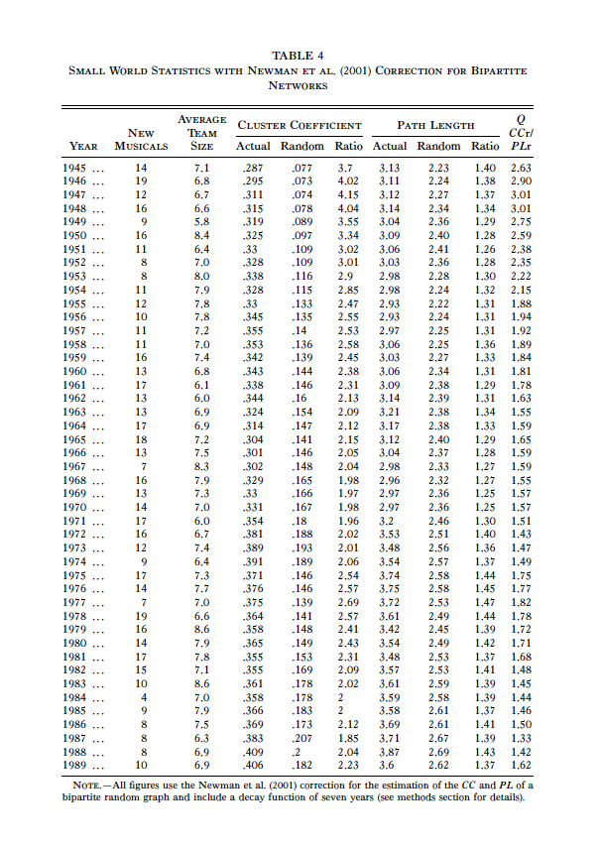
Notes:
Peaks in 1940s
drops until 1970s
rises into 1980s
drops again
constant PL ratio
constant CC actual
decreasing CC random

Slide 25
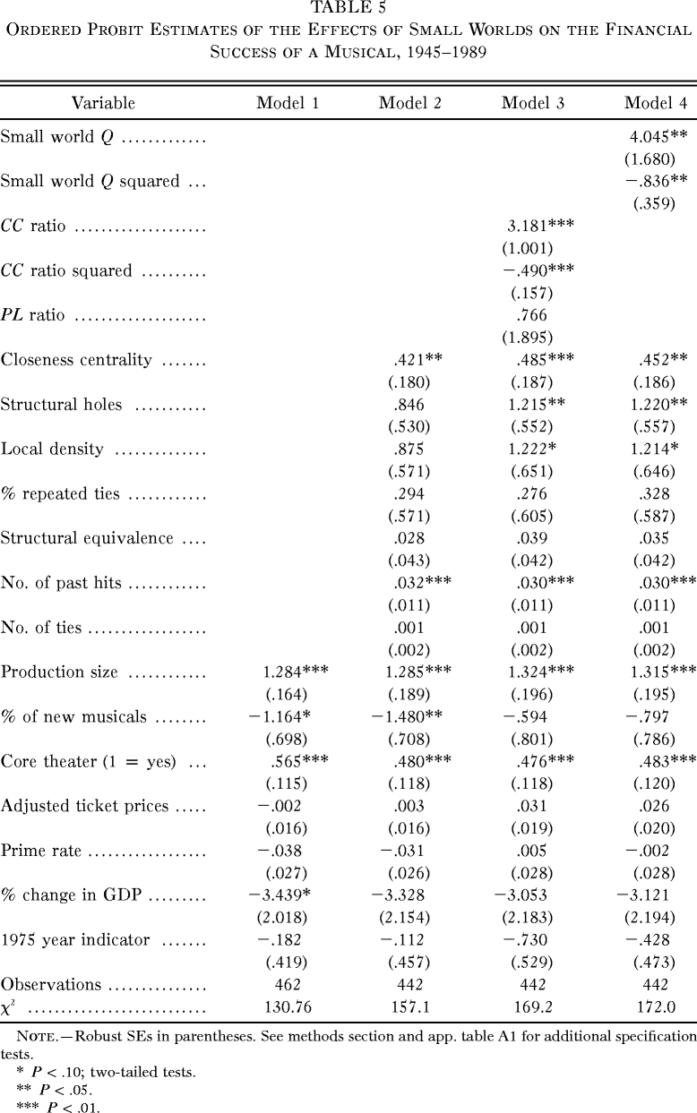

Slide 26
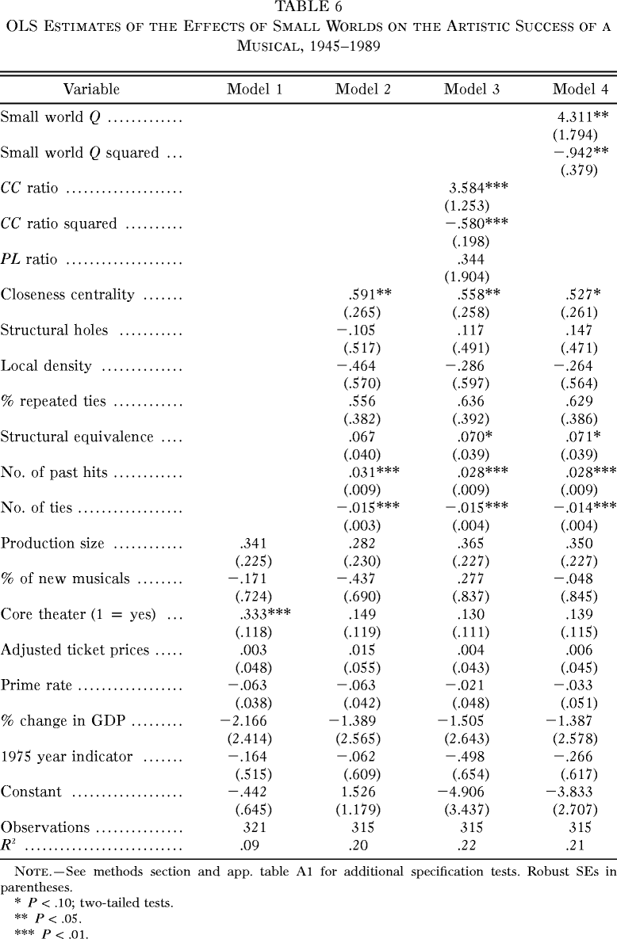

Slide 27
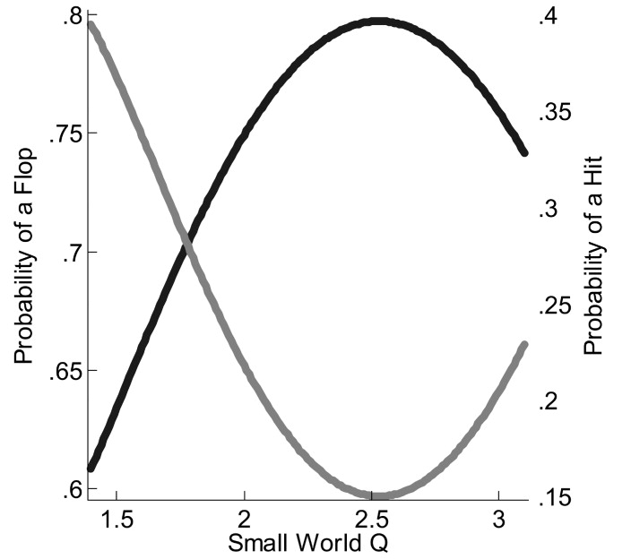
Financial success of a show

Slide 28
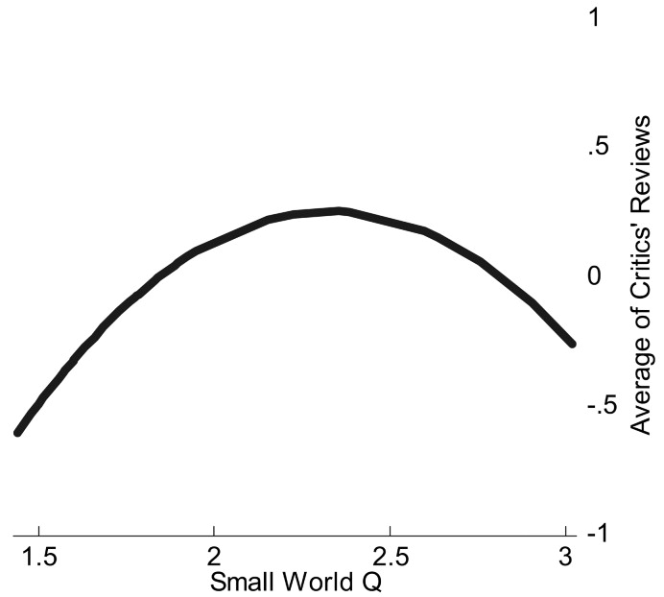
Artistic success of a show

Slide 29
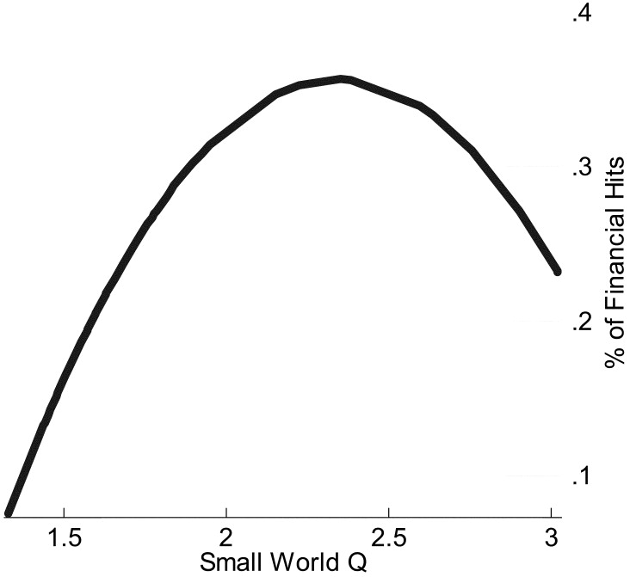
Financial success of a season

Slide 30
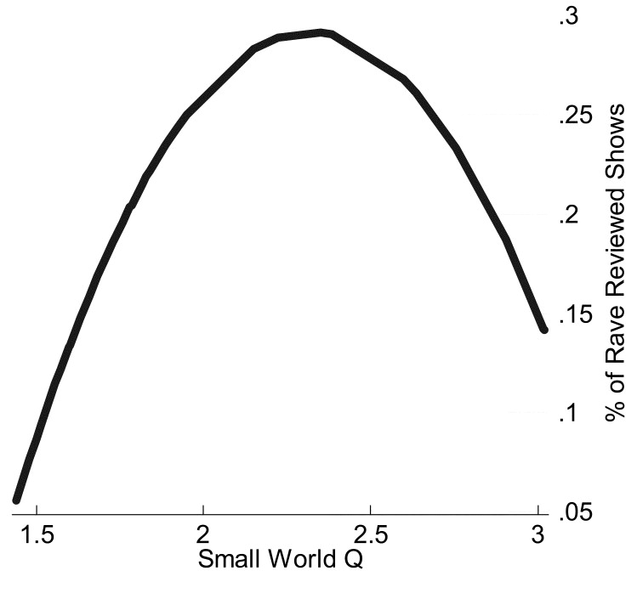
Artistic success of a season

Slide 31

Implications
Randomness and innovation
  CC random increased faster than CC actual
  random connections among artists
  choices of collaborators depended less on past collaborations

